Slide 1
우주궤도역학 Term Project #2
21013295 이진아

Slide 2
Transformation Step
Perifocal
(2D)
ECI
(3D)
ECEF
ENU

Slide 3
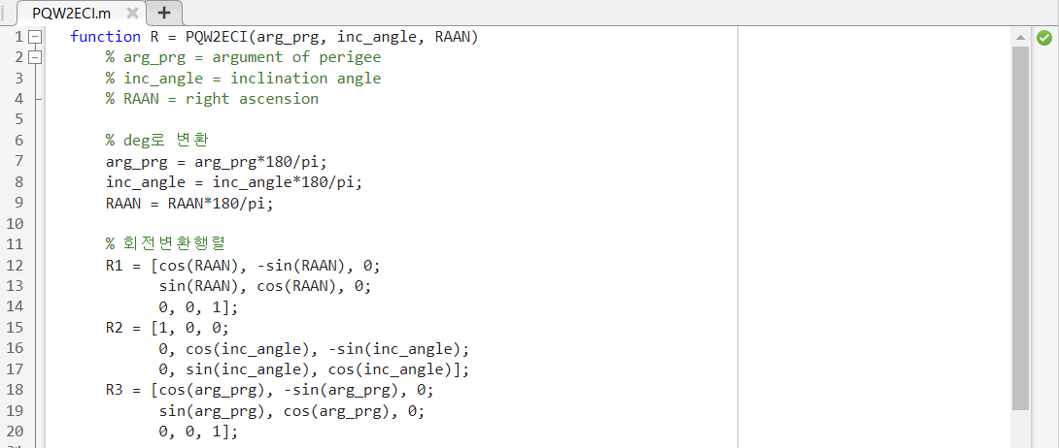
Matlab Code
1) Perifocal frame -> ECI frame

Slide 4
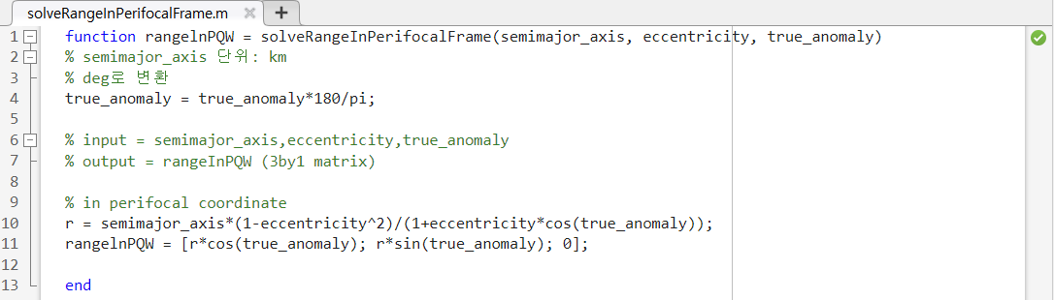
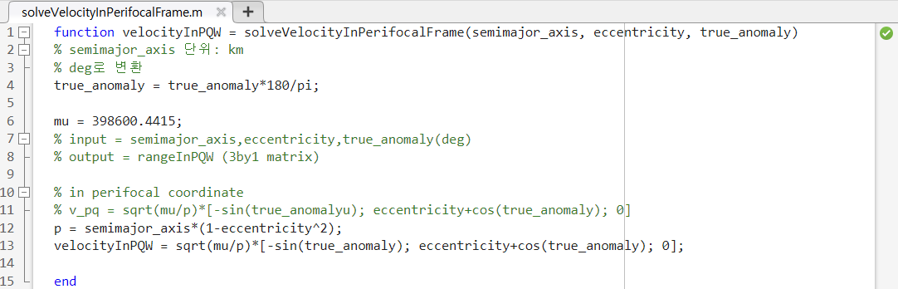
Matlab Code
2) r and v in perifocal frame from orbit parameters

Slide 5
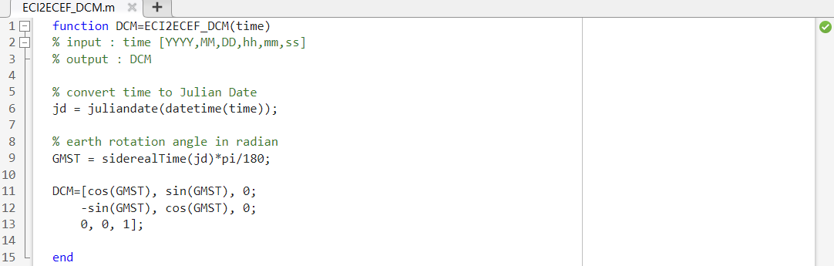
Matlab Code
3) ECI -> ECEF

Slide 6
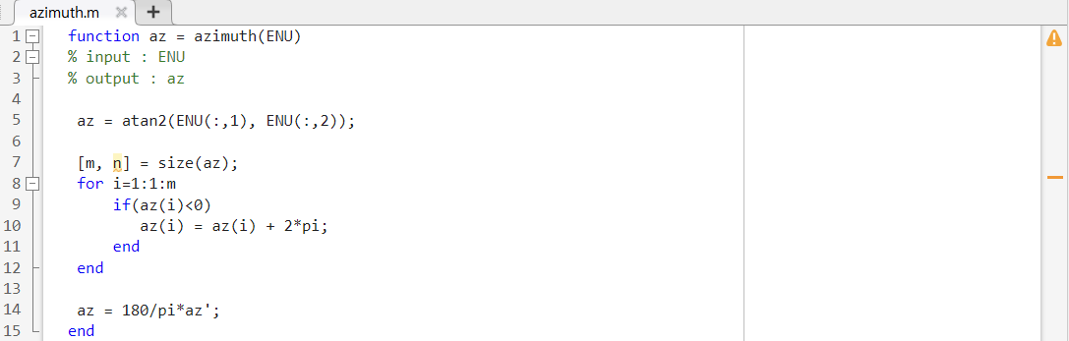
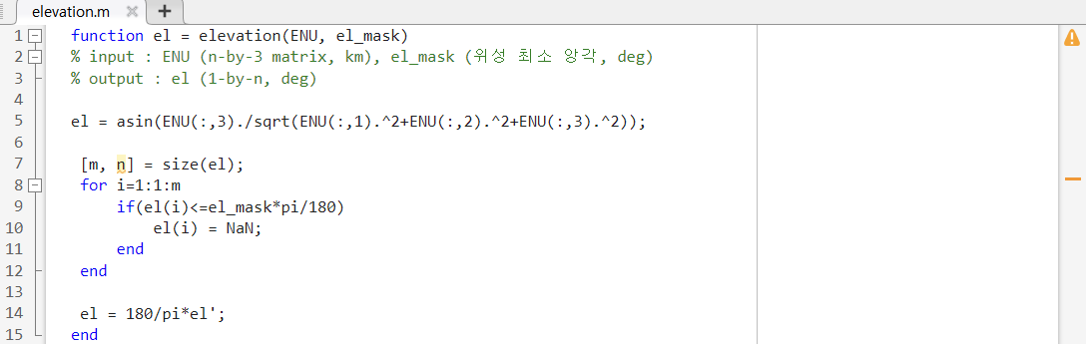
Matlab Code
4) Elevation, azimuth angle calculator

Slide 7
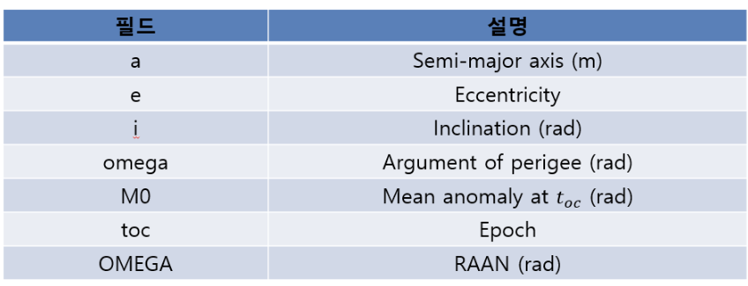
참고

